Slide 1
AZURE DATA ENGINEER PROJECT

Slide 2
Datasets:
In this Project, will be working on E-commerce datasets.
We have around 10 datasets from different sources.

Slide 3
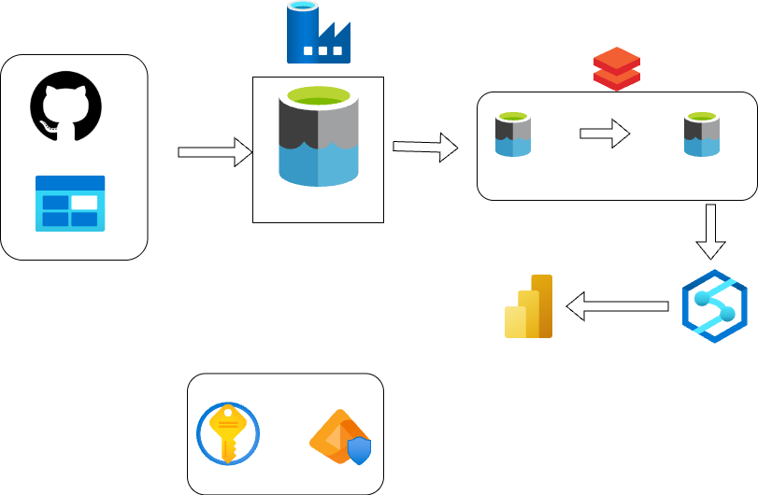
Data Sources
Intermediate
Layer
Publish Layer
Staging Layer
Security

Slide 4
Prerequisite:
Laptop or System with Stable Internet Connection.
Azure Account.
Basics or SQL or Pyspark Knowledge.

Slide 5
Ready……….?
Let’s get Started………………….

